Slide 1
CS551 Advanced Software Engineering
Tutorial 10
Node JS and MongoDB

Slide 2
MongoDB Connection
Required Modules:
mondodb
Installation:
Open project in command prompt
npm install mongodb
Format:
MongoClient.connect(url, function(err, db) {
});

Slide 3
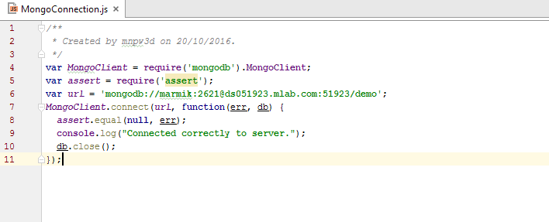
MongoDB Connection
Importing module mongodb
URL of Database
Connection Code

Slide 4
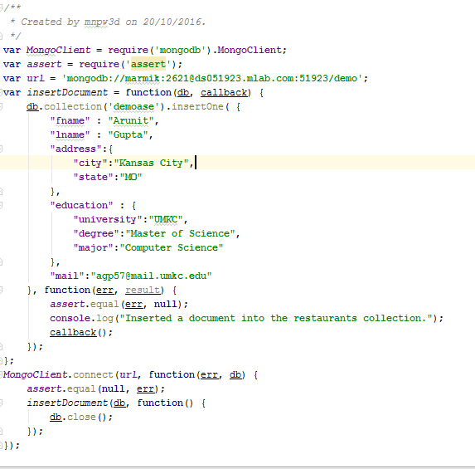
MongoDB Insertion of Data
Function to insert Data
MongoDB function to insert data
Handling Errors
Calling function in Method

Slide 5
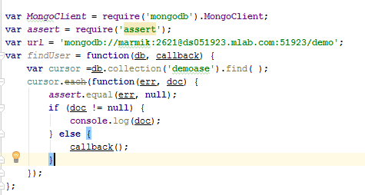
MongoDB Searching
Search all User:

Slide 6
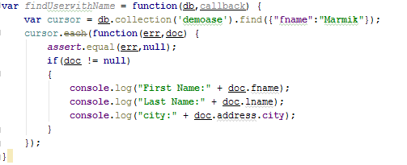
MongoDB Searching
Search all User By Name:

Slide 7
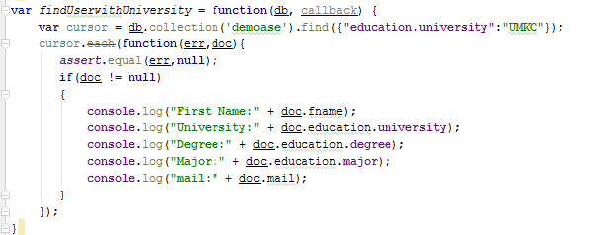
MongoDB Searching
Search all User By University:

Slide 8
MongoDB and Express Framework
Necessary Modules
mongodb, express, assert, body-parser, cors
Installing Modules
npm install mongodb
npm install assert
npm install body-parser --save
npm install cors
npm install express --save

Slide 9
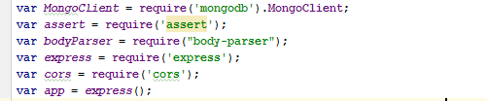
Creating REST service to insert data
Importing modules

Slide 10
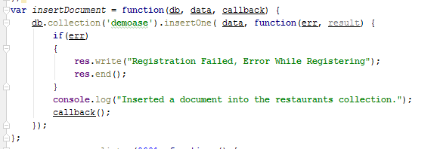
Creating REST service to insert data
Creating function to insert Data

Slide 11
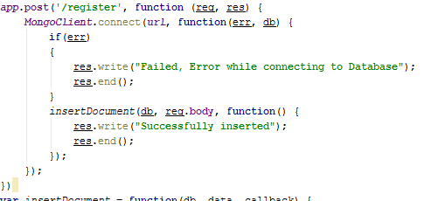
Creating REST service to insert data
Creating REST

Slide 12
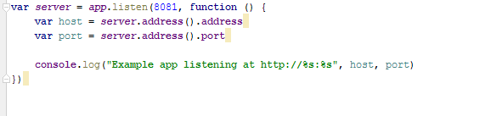
Creating REST service to insert data
Creating Server

Slide 13
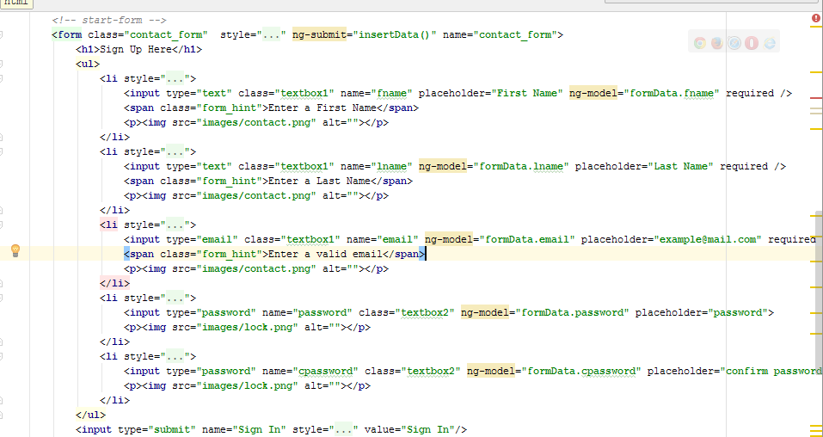
Consuming REST in Web Application

Slide 14
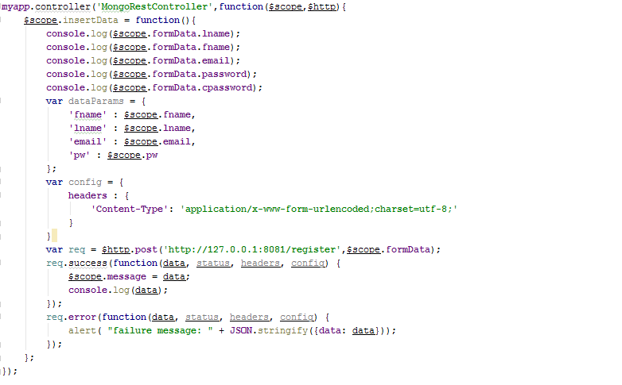
Consuming REST in Web Application

Slide 15
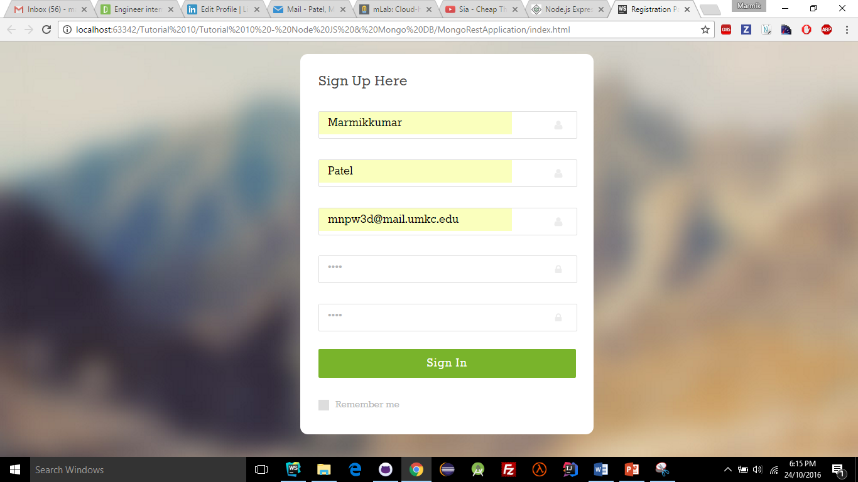
Consuming REST in Web Application

Slide 16
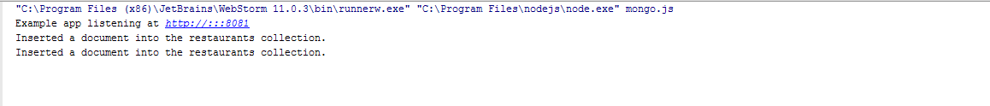
Consuming REST in Web Application
Output at Node.js

Slide 17
TASK
Create REST services for CRUD operation in MongoDB
Use this REST services and create Web Application which should have following features:
User can signup or login
After signup/login, in next page display all the users and details of user
Provide options for update or delete user data
Submit the screenshots of the task in wiki page and post the link for it in README.md file in Github and push the code to Source folder in Github.
Submit your Lab report through: https://goo.gl/forms/CbkTtsTjCb5KJVxu1

Slide 18
THANK YOU

